Slide 1
Using Videos in Teaching
Organic Chemistry
Featuring: Dr. Laurie S. Starkey
November 7, 2023
Notes:
Wiley to intro and welcome attendees

Slide 2
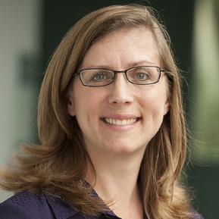

Our speaker
Video Creation & Student Motivation resources
Laurie Starkey
Cal Poly Pomona
lsstarkey@cpp.edu
Notes:
Wiley to intro Laurie
Dr. Laurie Starkey is a Professor of Organic Chemistry at Cal Poly Pomona, where she has been teaching since 1996. Her professional interests focus on the use of teaching with technology, including creating online tutorials, videos and animations, and developing multiple-choice questions for classroom “clickers” and the flipped classroom. She also authored a textbook, “Introduction to Strategies for Organic Synthesis” (from Wiley) and served for ten years on the GRE-Chemistry Committee of Examiners. She has a collection of resources for teaching and learning Organic Chemistry on her website chemistryconnected.com Laurie will be the co-author on the 5th edition of David Klein's Organic Chemistry.

Slide 3


Who doesn’t love videos?!
Why do students love videos?
Our students are digital natives
More appealing than reading textbook
Expected course resource (post-COVID reality)
If we don’t provide videos, students will fill the gap!
Self-reflection: are there situations where
YOU prefer to watch a video?
Images from Wikimedia Commons: Babies watching tablet by Alexander Dummer is in the public domain;
Black Man Looking at Phone GIF Animation Loop.gif by Videoplasty.com, CC-BY-SA 4.0

Slide 4
Why use video to supplement
Lecture and Textbook?
A great lecture can be great, but it cannot be…
PAUSED if a student needs to think
REPLAYED if not grasped immediately
REPEATED for exam review
CAPTIONED – not just for the impaired!
TRANSLATED into another language
DELIVERED to a student who is absent

Slide 5
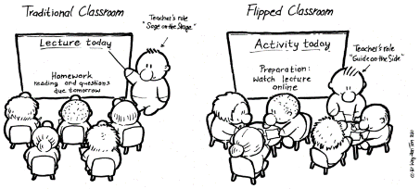
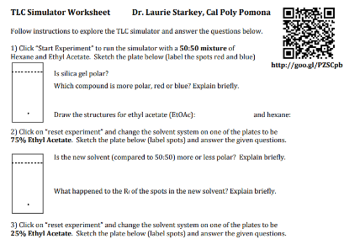
I have a video. Now what?
Range of Options for Video Incorporation
Flipping the classroom/lesson
Student watches video before class
Class time used for problem-solving
In-class groups watch video, discuss/respond
Assignment built around video
Video = recording of in-class lecture
(for review & for absent students)
Video as supplemental study resource
Image from Wikimedia Commons : FlippedClassroomDrawing by Weh-Han Tan CC-BY-SA 4.0

Slide 6
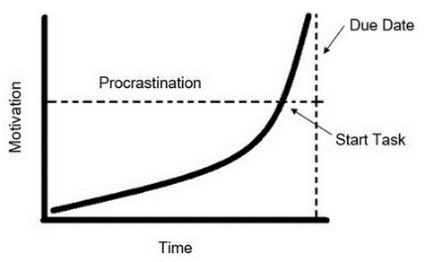
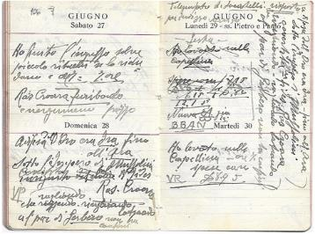
If you build it, they will come?
Getting Students to Watch the Videos
It’s all about Motivation!
How can we buy their time?
Assign POINTS or a GRADE
Provide a worksheet (e.g. TLC)
Assign a quiz (embedded?)
Discussion board entry
Written reflection
Assignment = Flipped classroom “ticket to ride”
Prioritization
Images from Wikimedia Commons : TimeandMotivationImage by Lturner2311, CC-BY-SA 4.0; 1936 Agenda by Albertomos , CC-BY-SA 4.0

Slide 7
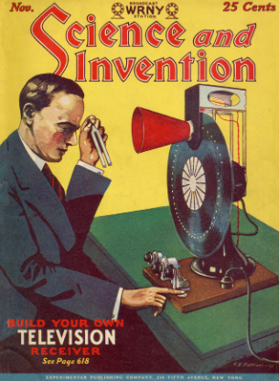
Not all Videos are Created Equal
Where can I find videos?
  Create your own videos, but…
  don’t reinvent the wheel!
    Videos from textbook publisher
    LOCAL (Starkey repository)
    MERLOT (Cal State repository)
    PhET (UC Boulder simulations)
    YouTube (CAUTION!)
Image from Wikimedia Commons : Science_And_Invention_Nov_1928_Cover by Experimenter Publishing, Public Domain

Slide 8
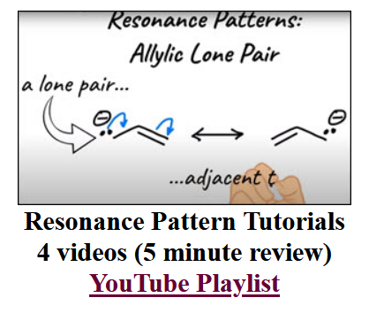
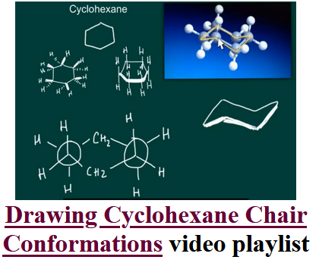
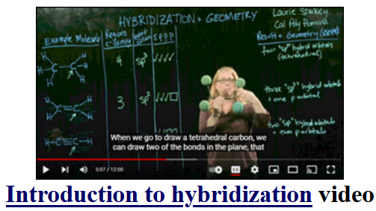
Video Resources at Chemistry Connected…

Slide 9
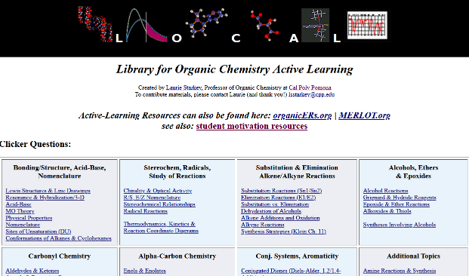

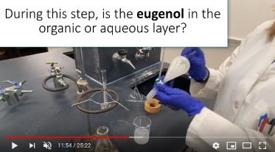
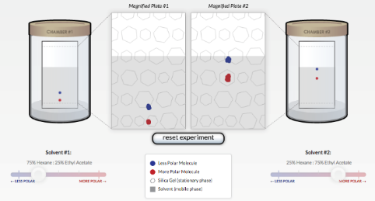
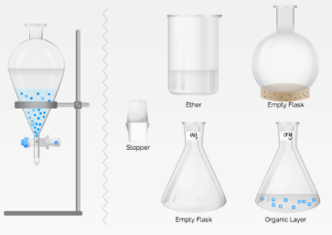
…and More Resources for Teaching O-Chem
O-Chem Active Learning Repository
Clicker Questions
Flipped Classroom Worksheets
ChemistryConnected.com
“Inquisitive”
lab demos
eugenol video
>18,000 views
since March 2020
Lab Animations
TLC &
Extraction
https://www.youtube.com/chemistryconnected

Slide 10

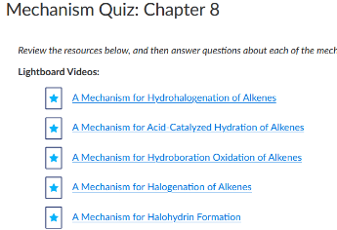
~300 Lightboard Videos in WileyPLUS
Every SkillBuilder and Mechanism
  Featuring the Author, David Klein
  Matches textbook, exceptional detail
  Video: dynamic nature of mechanisms, problem-solving
  Great for review: midterms, 2nd semester, ACS exam
  Mechanism problems can be assigned
    Chapter quiz is pre-built
    (3 Questions per mechanism)
Notes:
This is a slide I pulled from the Klein event you guys did back in March. There is a link directly from the image. The link is also below the image, and again listed below here.
https://players.brightcove.net/pages/v1/index.html?accountId=4931690914001&playerId=iQuFKvrOI&videoId=6322020223112&autoplay=true

Slide 11
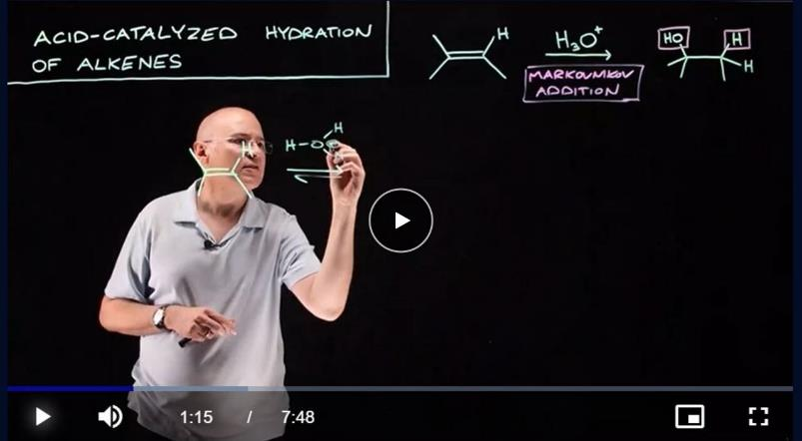
A Mechanism Video Example
https://players.brightcove.net/pages/v1/index.html?accountId=4931690914001&playerId=iQuFKvrOI&videoId=6322020223112&autoplay=true
Notes:
This is a slide I pulled from the Klein event you guys did back in March. There is a link directly from the image. The link is also below the image, and again listed below here.
https://players.brightcove.net/pages/v1/index.html?accountId=4931690914001&playerId=iQuFKvrOI&videoId=6322020223112&autoplay=true

Slide 12

The devil is in the details
I have Videos. Now What?!
How NOT to implement videos in the classroom:
Fail to get student buy-in
Fail to provide clear instructions
Assign it and don’t refer to it
Repeat video content in class
Image from Wikimedia Commons : Mad_Red_Emoticon by Offnfopt, Public Domain

Slide 13
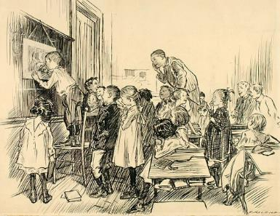
Fool-proofing* the Flipped Classroom
  Get student buy-in, solicit feedback
  Start small
    e.g., flip your nomenclature lesson
  Don’t fly solo
    Collaborate with colleagues (Facebook groups, f2f)
  Provide a brief review before problem-solving
    Student may have watched video a few days ago
Image from Wikimedia Commons : The_Schoolroom-saam by Smithsonian American Art Museum, Bequest of Olin Dows, Public Domain
*Sorry, but there is no such thing. Mistakes will be made. There may be tears.

Slide 14
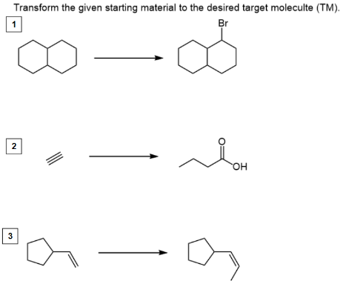
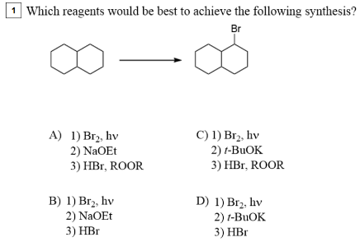
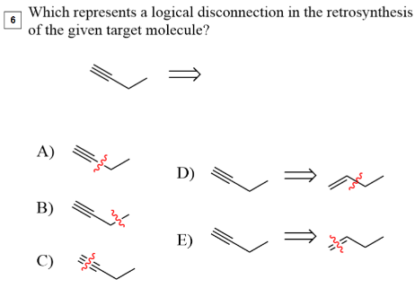
Clicker Questions & The Flipped Classroom
Creative clicker

Slide 15
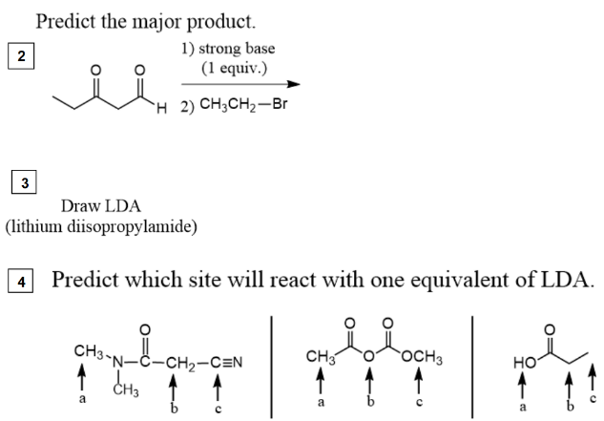
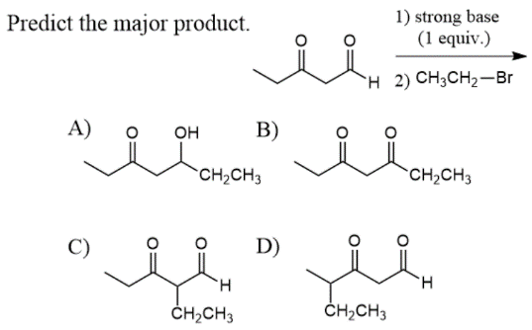
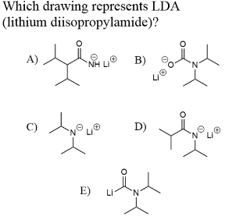
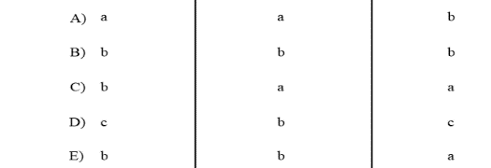
Clicker Questions & The Flipped Classroom
Creative clicker

Slide 16
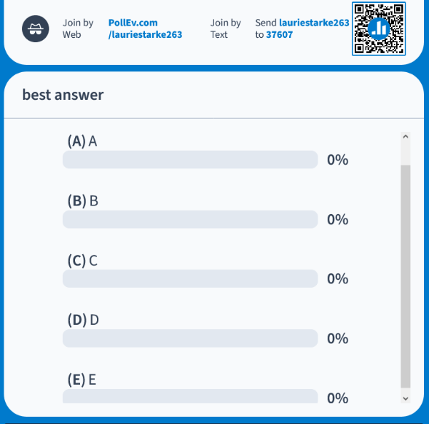
Poll Everywhere
Free! Capped at 40 responses
Anonymous log in
Can set up Qns in advance
I only need/use one question for every worksheet problem:
“What is the best answer?”
A/B/C/D/E

Slide 17
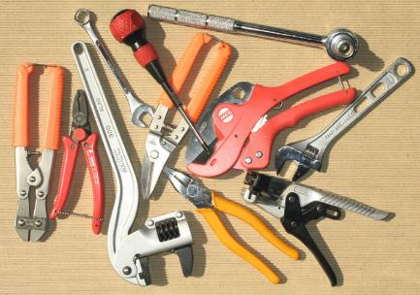
Fast, free & forever
Making Videos: Selecting the Right Tool
Free? Look for trial versions
Advice/training from Faculty Center?
Video can be downloaded/
stored offline?
Product reputation? Longevity?
Image from Wikimedia Commons : Hand tools by M338, Public Domain

Slide 18
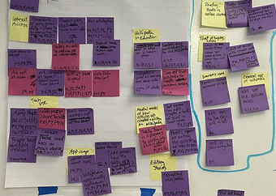
Getting started and moving forward
Planning a Video Project
Identify the learning objectives
“After watching this video, the student will be able to…”
Create a storyboard/outline (script?)
Maximum length = 6 minutes!
Get IRB approval (SoTL)
Gather materials, support
Record beta version, gather feedback
Images from Wikimedia Commons : Post_its_of_patterns by Wikimedia Foundation CC-BY-SA 4.0

Slide 19
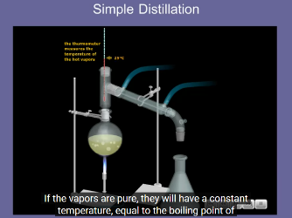
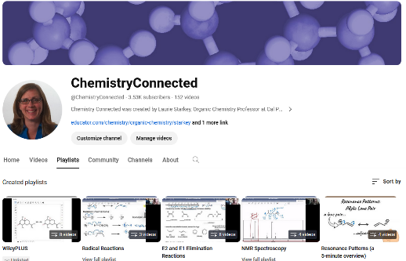
Same Bat Time, Same Bat Channel
Maximizing Your Video’s Impact
  Make a YouTube channel!
  ChemistryConnected
  created in 2012
  nearly 1.2 million views
  over 3,500 subscribers
    Pre-lab tutorials, solved problems, o-chem lectures,
    demos of hands-on elementary school science activities
    50% of the views have come from outside the U.S.
    (200 different countries)
    http://www.youtube.com/user/ChemistryConnected

Slide 20
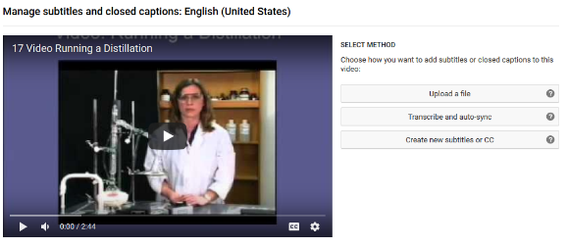
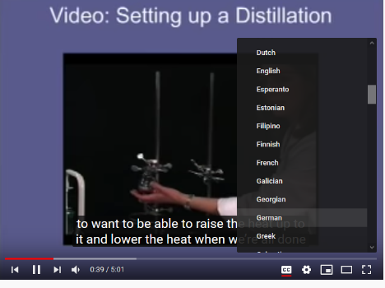
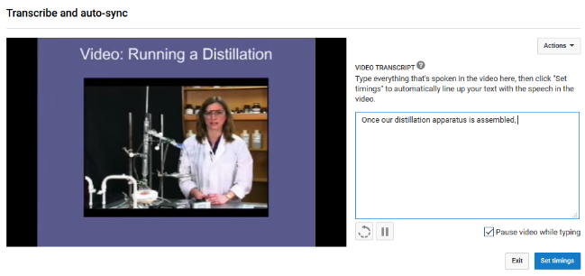
¿Hablas Español? ¡Si!
Using YouTube Studio to add Captions
Notes:
Laurie: You Will need to play around with the images on this slided a bit. I did not want to mess around with them too much because of the blue call-outs/circes that showcased certain words, but ideally the images should not go below the blue background and into the white bar at the bottom. Hope that makes sense.
I changed it to this (below) which i think is correct. ☺ ¡ ¡Olé!!
¿Hablas Español? ¡Si!

Slide 21
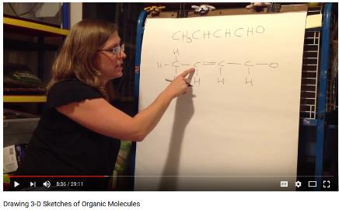
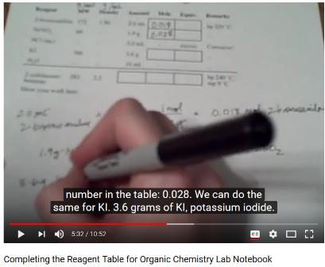
Old school videos
Making videos the old-fashioned way
  Record a presentation with video camera
  Need tripod or videographer
  (studio at your institution?)
  Pros
    quick & easy
    instructor-student relationship
  Cons
    Limited (or zero) editing options
    Poor resolution
3D sketch
  reagent table

Slide 22
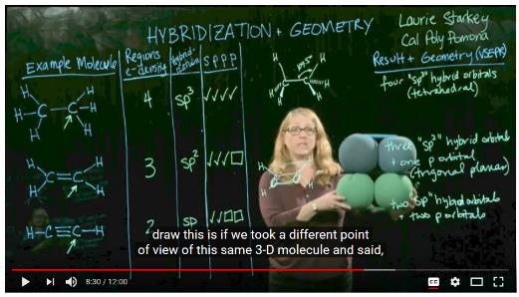
Evolution from a blackboard…to a white board…to a light board!
21st Century lecture: transparent lightboard
Present a lecture with a Learning Glass/ lightboard!
Neon writing + maintaining eye contact = captivating lecture!
Inexpensive to build
(how it works)

Slide 23
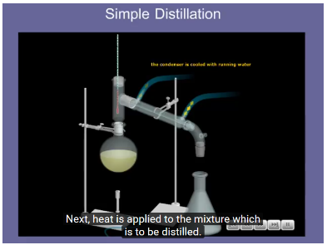

The gold standard for screencasting
Camtasia: screen capture & video editing
  Uses screen capture (while recording voice) to make videos
  Great for demonstrating software
  PowerPoint integration
  Advanced editing tools (learning curve)
  Tutorials: http://tiny.cc/CreatingPedagogicalVideos
  Examples: tutorial and solved problem

Slide 24
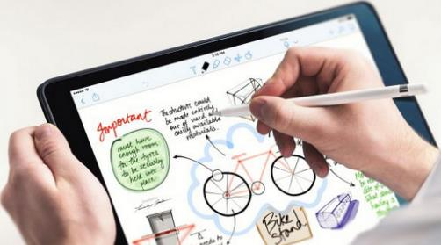
I my Apple pencil
iPad/Tablet Screen Capture Apps
  Screencasting = records voice + writing
  Import slides/graphs/images for markup
  Export videos to camera roll
  Best stylus = Apple pencil
  Can be used during lecture
  (Airplay to project on screen)
Image from Amazon: TiMOVO-Feel-Paper-Protector-Paperfelt-Removable

Slide 25
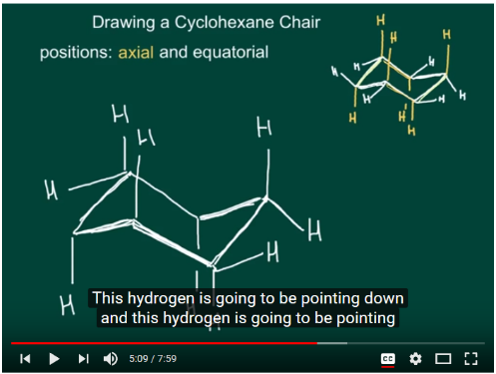
Explain Everything
Explain Everything – Simple Screencasting
Quick startup, easy to use
Free version = a single slide
Limited editing options
Drawing Cyclohexane Tutorial

Slide 26
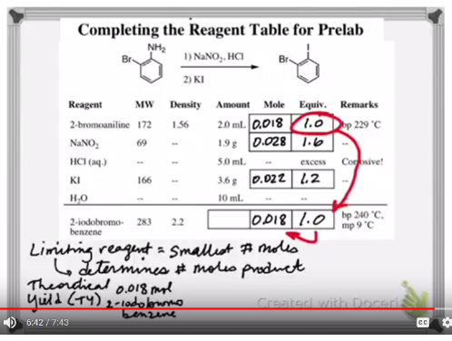
Harry Potter-style writing appears on the screen
Doceri – Magically reveal writing as you lecture
Write out complete lecture
Add stop markers to timeline
Begin recording, hit PLAY
Words appear as if writing in real time
Discuss freely, markup notes…
no multitasking!
More personal look/feel than PowerPoint
Reagent Table

Slide 27


YOU get an app! And YOU get an app!
Other Screen Capture Apps
GoodNotes – popular with students
Screencast-O-Matic – free for PC, Mac
TouchCast
And many more

Slide 28
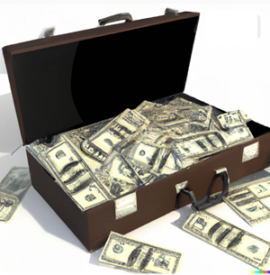
If you build it, will they come?
Student Buy-In & Institutional Support
  Keep videos short &
  rich with multimedia
  Faculty Learning Communities
  Course Redesign Initiatives
  Collaborate with colleagues, tech-savvy students
Image created by L. S. Starkey using DALL-E AI
Notes:
There was something weird going on with the bullet point spacing on this one and I could not figure it out, so I just made an extra hidden bullet between point 3 and 4 and it pretty much equals the other spacing. Again, I hope you know what I mean.

Slide 29


Equal parts excited and terrified
Final Words of Advice
  Start small, focus on one SLO
  Don’t aim for perfection
  Seek formative feedback
  Embrace your role as a lifelong learner
  Have fun!
Image from Wikimedia Commons: Retman by Razvanantonescu, Public Domain
Notes:
Bullet spacing is different here than others but looks okay. Did not change.

Slide 30

THANK YOU!
Dr. Laurie Starkey
Cal Poly Pomona
lsstarkey@cpp.edu
Q&A

Slide 31


