Slide 1
Technology-Infused Teaching for Engagement & Student Success
Dr. Laurie S. Starkey
Chemistry & Biochemistry Dept.
Cal Poly Pomona
lsstarkey@cpp.edu
Wiley EdTech Forum
Dana Point, CA, March 2017

Slide 2
Deep, Sustained Learning Comes from Building Relationships
Teaching & Learning
Transfer of Information
≠
RELATIONSHIPS
Teacher
Student
CONTENT
Subject

Slide 3
How can use of TECHNOLOGY promote learning?
Well-organized professor
Engaging lecture presentation
Variety of teaching methods employed
makes material accessible
keeps students active and focused
audio, visual, hands-on
Well-defined learning outcomes and clear expectations
Professor cares about student’s learning
Abundant and timely feedback provided
know what the goal is and how to achieve it
Should this matter? Why does it?
assessment, keep on track, improve
Affective Domain
Student has interest in subject matter
Reasonable work/academic schedule
Student is healthy: sleep/diet/exercise
easier to make the needed commitment
time available to dedicate to class work
receptive mind/body

Slide 4
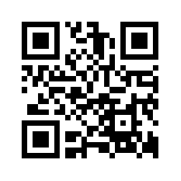
Skeptical Philosophy: I don't use technology for the sake of technology.
PowerPoint presentations can be boring and passive; a “chalk” talk is much more engaging!
Teaching with Technology, my personal journey
1996 Website www.cpp.edu/~lsstarkey
2000 Distillation image map (Photoshop)
2001 Online pre-lab quizzes (WebCT/Bb)
2002 Calibrated Peer Review (CPR)
2007 Pre-lab online tutorial videos
2008 Classroom Response System (iClicker)
2014 Using online homework in Organic Chem Classes...
QR Code for my homepage

Slide 5
Technology for Lab Preparation
Online Quizzes (WebCT, Blackboard): instant feedback, assessment
Online Tutorials (Adobe Presenter, Flash/HTML5 animations, filming of demos, captioning) http://www.cpp.edu/~lsstarkey/ochemlab over 35,000 worldwide visitors to website since 2008
Benefits: unlimited time, asynchronous, reviewable, available in the future (website/YouTube vs. LMS)

Slide 6
Assessment of Technology Prelab Quiz: Overall Score
Spring 2007: 29 students watched entire video; 7 watched some
Mean = 30/65
Mean = 50/65

Slide 7
Assessment of Technology Prelab Quiz: Sketch Distillation Apparatus
Percent of Students at each Score (Max Score = 10 points)

Slide 8
Assessment of Technology Prelab Survey: Confidence in Running Distillation Experiment
Mean = 5.0
Mean = 7.6

Slide 9
Tech-Assisted Lab Preparation: Student comment
“I have never before taken a lab course at this university where so much help was provided for preparing for the lab. Between the Blackboard quizzes and online tutorials I always felt I had enough preparation for the lab, and this helped me perform better and understand the actual experiment.” CHM 317L, Fall 2012

Slide 10
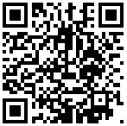
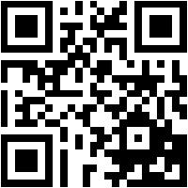
Tech-Enabled Classroom Engagement
STEM demos, simulations and animations on YouTube CHM 315 (free, no hazards, can pause/watch later, etc.) to find resources: MERLOT.org
“Clickers” (CRS) www.clickerquestions.com
Kahoot – gameshow-style M/C questions using mobile devices getkahoot.com
TodaysMeet – smart phone chat tool todaysmeet.com/wileyedtech
Class participation resources, including low-tech! www.stephenbrookfield.com (Workshop Materials link)
QR Code to play Kahoot
QR Code for TodaysMeet

Slide 11
Tech-Enabled Communication
Public course home page (vs. LMS) is not restricted to current students: handouts, sample exams, answer keys, clicker questions, links to tutorials/resources, etc.
Virtual office hours the night before an exam (via LMS or Adobe Connect)
broader participation than f2f office hours, chat, Q&A, whiteboard, encourages supervised peer-to-peer learning, sessions can be recorded
Calibrated Peer Review (CPR) writing assignments
Wikis - sharing resources for research students, extra credit assignment

Slide 12
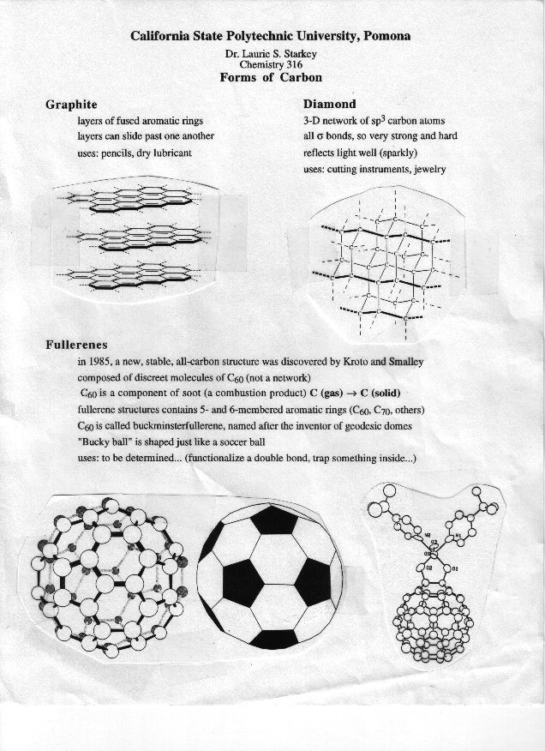
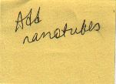
Teaching Innovation Inspired by Faculty Learning Community (CPP FCPD)
Old-school approach
Handout from ~1997
Previous goal: revise handout
Tech-assisted approach
Make a wiki!
Extra credit assignment PBWorks.com

Slide 13
Nanotube Wiki

Slide 14
Nanotube Wiki: Student Comment
“'Asbestos warning' on nanotubes (By Jonathan Fildes Science and technology reporter, BBC News) As a Biology major, I thought that looking and researching about nanotechnology would be dull and boring. It proved to be really interesting. There are so many wonderful things being written about nanotubes and how they can make a huge impact despite their "nano" size. I was wondering if there were any sort of risks that came along with this new technology. I came across an article that was put out by BBC News about the possible negative effects of nanotubes. The researches compared the molecular structure to that of asbestos, which earlier cause a pandemic of lung disease in the 20th century…. As a bio major, its interesting and exciting to see the worlds of Ochem and Bio clash. Here is the link to the article. I found it really interesting. :)”

Slide 15
Tech-based teaching supplements to improve student success
Skill-building, drill-type quizzes (create in LMS or available from publisher)
Online homework system - immediate feedback, autograding
Adaptive learning (e.g., ORION) – measures competency level for each SLO and customizes assignments to be strategically focused
Collection of Mobile learning resources

Slide 16
Making videos for the flipped classroom & beyond
Online lectures – search YouTube, Educator.com, EdX
Create your own! “Old school-style” recording of narrated homework solutions (iPhone) 3D sketch reagent table
Latest technology: transparent lightboard! (Biology example)
Record and edit videos with Camtasia (screen capture/voice) Tutorials: http://tiny.cc/CreatingPedagogicalVideos Examples: Engineering tutorial and solved problem
Lecture-capture w/iPad apps - can export videos to YouTube Explain Everything cyclohexane and Doceri CPP Engineering

Slide 17
Sharing your work
Private (LMS) or Public (webpage link, MERLOT)
Include captioning for accessibility (Hablas Español? Si!)
Maximum exposure: make a YouTube channel!
ChemistryConnected, created in 2012, has over 365,000 views and over 750 subscribers
Pre-lab tutorials, solved problems, demos of hands-on elementary school science activities
Over half the views have come from outside the U.S. (200 different countries) http://www.youtube.com/user/ChemistryConnected

Slide 18
Chemistry Connected YouTube Channel

Slide 19
Making it Academic – SoTL Research
Turn your innovation into a research project!
Formulate a question
Collect data (can be a great “wow” factor)
Get IRB approval (Human Subjects)
Pre- vs. Post-Intervention
Quantitative and Qualitative data
Perform assessment; analyze data
Share results with colleagues and the world!
Conference paper, Ed. Journal article, RTP

Slide 20
Getting Buy-In and Support from Students, Faculty, Institution
Poorly implemented technology is unlikely to succeed
If you are enthusiastic, students are likely to be too
Explain WHY you do what you do – pedagogy matters!
Share data and testimonials and data with colleagues
Institutional $upport: workshops, summer institutes, release time, mini-grants, free iPads (!), Faculty Learning Communities (clicker, SoTL, technology)

Slide 21
Variety in Teaching = Engaged Students
Audiovisual presentations blows away text
Interactive lessons exercise different "muscles"
Teaching to learning styles is a “neuromyth,” but captioning benefits ALL learners
Online tools offer asynchronous and mobile delivery, pause button, unlimited replay, etc.
Most students need more than textbook support! Online homework and adaptive learning tools enable immediate feedback/formative assessment

Slide 22
Tapping into the Affective Domain
How the student feels about the class affects learning! (technology-infused learning can be fun, interesting, engaging, informative, helpful, shiny and new)
How the teacher feels about the class affects teaching! (technology-infused teaching can be fun, interesting, engaging, invigorating, efficient, shiny and new)
Students learn better if they feel the instructor cares about their learning. Students appreciate the effort you put in to support their learning. Does a better attitude about you, about the class, about the subject = better learning? Encourages productive persistence!

Slide 23
Support & Acknowledgments
CPP Faculty Center for Professional Development
Investigating Teaching & Learning Fellowship, Connecting Learning & Technology FLC, Clicker FLC, countless workshops
CPP eLearning (I&IT), CPP Mediavision
Flash animations & video production
CSU Course Redesign with Technology Grants x3
Summer Institute + Course Release + Stipend
CSUPERB Grant (CSU Biotech. Education & Research)
Summer stipend to create pre-lab tutorials

Slide 24
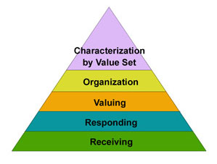
References
Bloom’s Taxonomy - Affective Domain (Carleton College) http://tiny.cc/nx5ujy (UConn) http://tiny.cc/4e6ujy
Calibrated Peer Review (CPR) http://tiny.cc/j05ujy
Online lab tutorials created with Adobe Presenter (Starkey) http://tiny.cc/t15ujy
Collection of Mobile learning resources http://tiny.cc/g45ujy
Tutorial for captioning YouTube: http://tiny.cc/u65ujy
Teaching to “learning styles” is ineffective http://tiny.cc/275ujy
Productive Persistencehttp://tiny.cc/rt6ujy

