Slide 1
Wiley Teaching and Learning Summit
Working Together to Drive Student Engagement and Success

Slide 2
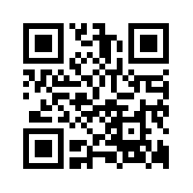
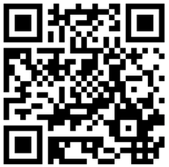
Today’s EdTech: Tuning in, getting turned on, and building relationships
QR Code for my homepage
Dr. Laurie S. Starkey
Cal Poly Pomona
Chemistry & Biochemistry Dept.
QR Code for my homepage
Teaching & learning resources

Slide 3
Goal: deep, sustained learning Challenge: how do we…
Keep our students coming to class…and awake in class?
Maintain communication with our students?
Help develop confidence and community?
Know where our students are struggling?
Help students identify where they are struggling?
Provide help when students need it? (24/7!)
Help students who can’t come to class?
Provide abundant and timely feedback?
Stay excited about teaching the same class year after year?
Technology can help!

Slide 4
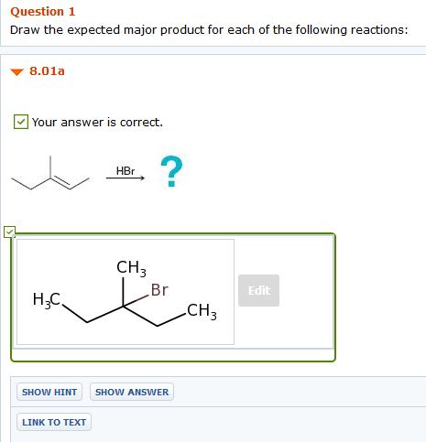
Teaching & learning with technology
Online Homework = Favorable Feedback
Online homework from publisher (24/7 and immediate feedback, auto-grading)
Skill-building, drill-type quizzes (can create in Blackboard)
Adaptive learning
measures competency level for each SLO and customizes assignments
STEM: ideal for students with weak pre-requisite skills

Slide 5
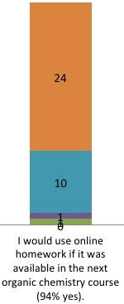
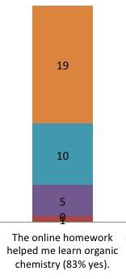
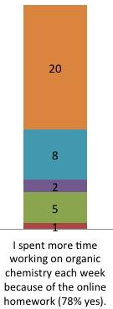
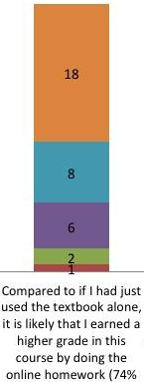
Teaching & learning with technology
Online Homework = Favorable Feedback

Slide 6
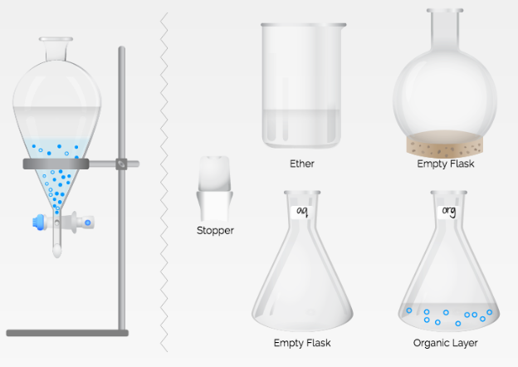
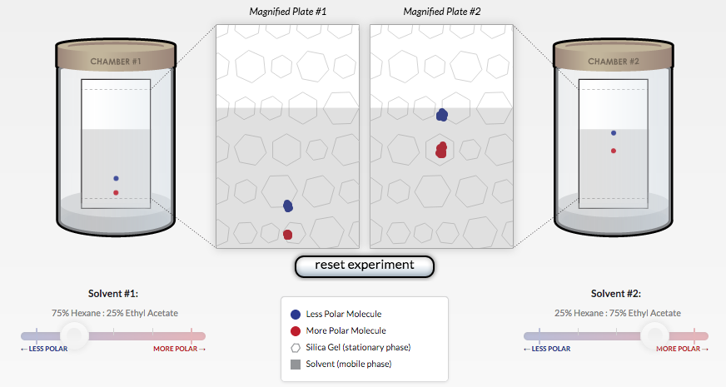
Teaching & learning with technology
Technology for Lab Preparation
Online Quizzes (Blackboard): 27/7, instant feedback, formative assessment
Animations (with worksheet) TLC | Extraction

Slide 7
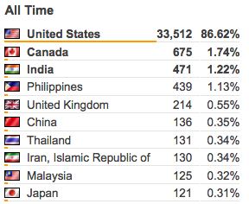
Teaching & learning with technology
Technology for Lab Preparation
http://www.cpp.edu/~lsstarkey/ochemlab
Online Tutorials - Adobe Presenter (Pp plug-in)
- Flash/HTML5 animations - filming of demos
- over 38,500 worldwide visitors
to website since 2008
Benefits: unlimited time, asynchronous, reviewable, available in the future (website/YouTube vs. LMS)

Slide 8
Assessment of technology
Prelab Quiz: Sketch Distillation Apparatus
Percent of Students at each Score (Max Score = 10 points)

Slide 9
Assessment of technology
Prelab Survey: Confidence in Running Distillation Experiment
Mean = 5.0
Mean = 7.6

Slide 10
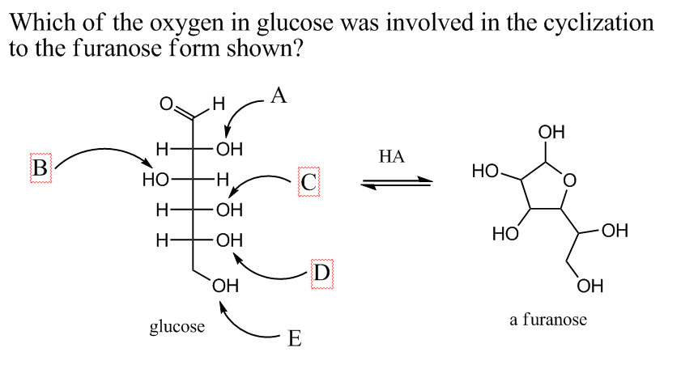
Classroom engagement
Tech-Enabled Classroom Engagement
iClicker (CRS)
formative assessment (for students & faculty)
Activity every 15 mintues transition/wrap-up
o-chem repository

Slide 11
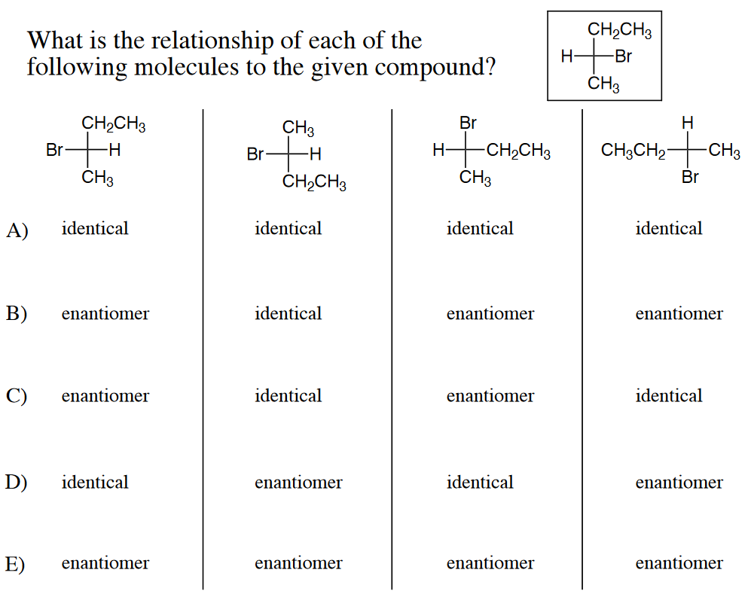
Classroom engagement
Tech-Enabled Classroom Engagement
I’m never going back to a clickerless class!
More embedded questions
Highlight common errors
Encourage student participation, collaboration (think/pair/share)
Click = Commitment!

Slide 12
Creative clicker
How much work have you done in CHM 314 so far to prepare for Exam 1? (Thurs., 10/22)
A) I read chapter 1 and worked ALL of the suggested problems. I have started reading/working on chapter 2.
B) I read chapter 1 and worked MOST of the suggested problems. I read chapter 2 but haven't tried any problems yet.
C) I read chapter 1 and worked some of the suggested problems. I haven't looked at chapter 2 yet.
D) I looked up the answers to some of the problems in chapter 1 and I knew I could do them.
E) I've come to every lecture and have no trouble following along, but I haven't done much with the book or online problems yet.

Slide 13
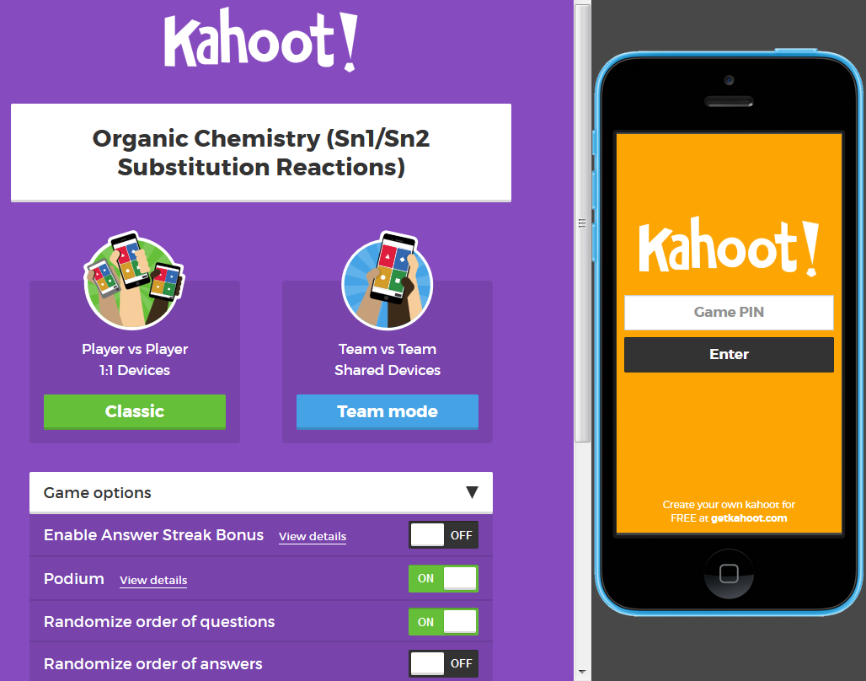
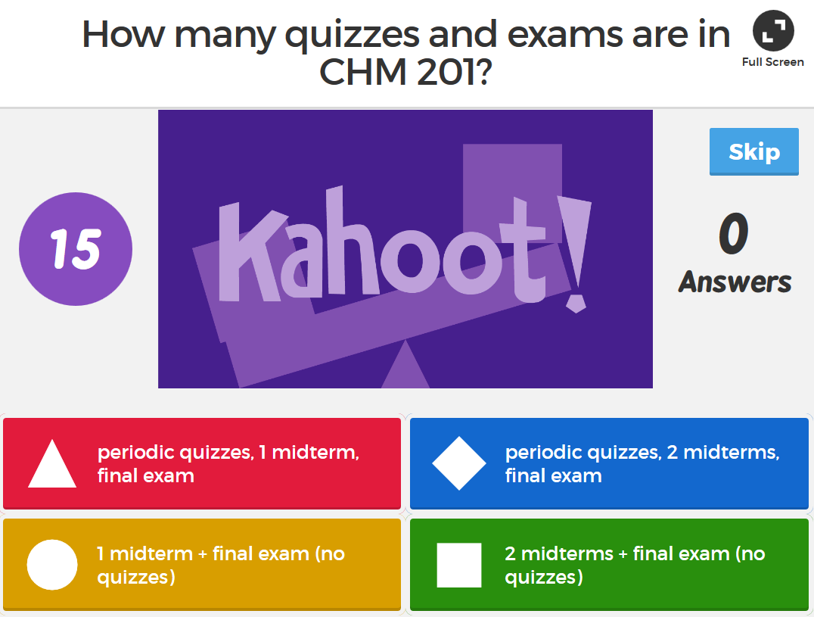
Classroom engagement
Tech-Enabled Classroom ENGAGEMENT
Kahoot – gameshow-style M/C questions using mobile devices getkahoot.com (good for syllabus quiz, review)

Slide 14
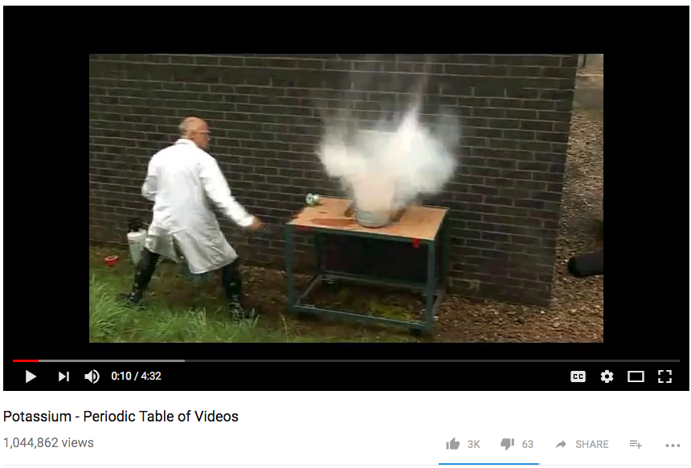
Classroom engagement
Tech-Enabled Classroom engagement
YouTube demos, simulations, animations - free, no hazards, can
pause/watch later, etc. - find resources: PhET, MERLOT.org
- can support a flipped classroom model

Slide 15
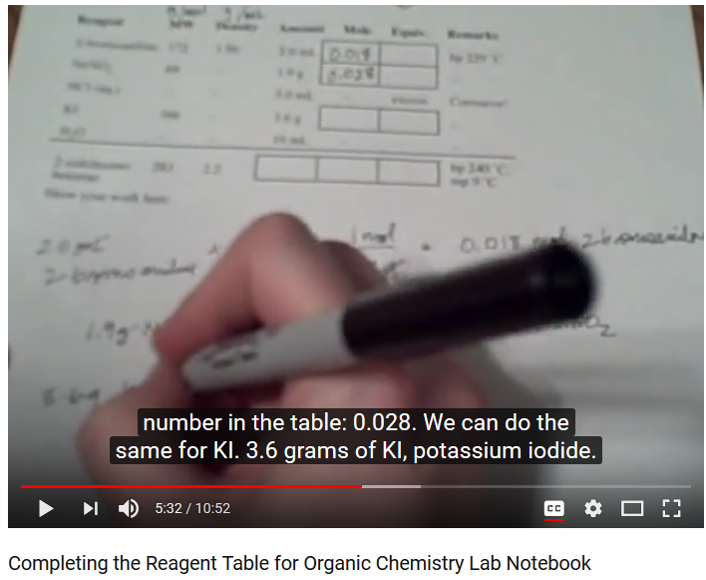
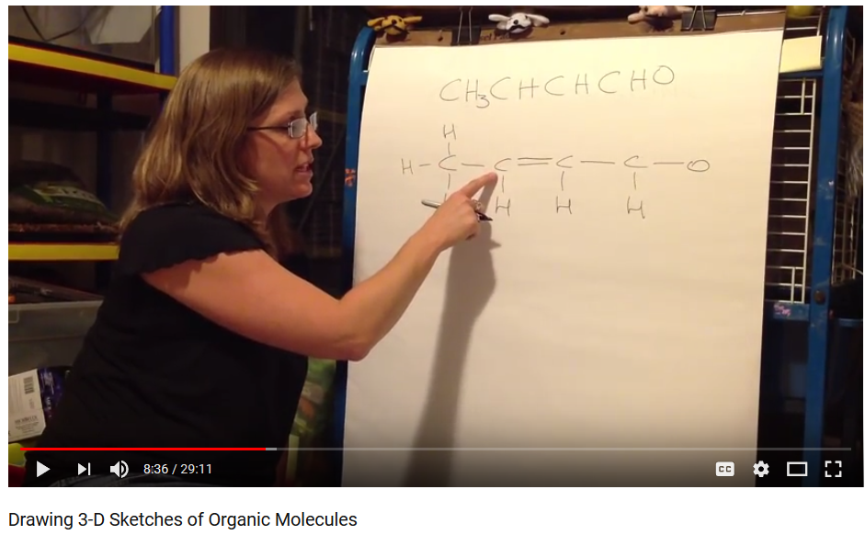
Making videos
Making videos for the flipped classroom & beyond
Online lectures – search YouTube, Educator.com, EdX
Create your own! “Old school-style” recording of narrated homework solutions (iPhone) 3D sketch reagent table

Slide 16
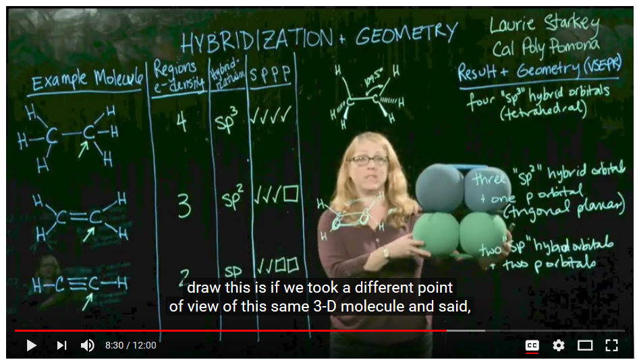
Making videos
Making videos: transparent lightboard
Latest technology: transparent lightboard!
(how it works)

Slide 17
Making videos
Making videos: Camtasia
Record and edit videos with Camtasia (screen capture/voice) Tutorials: http://tiny.cc/CreatingPedagogicalVideos Examples: Engineering tutorial and solved problem

Slide 18
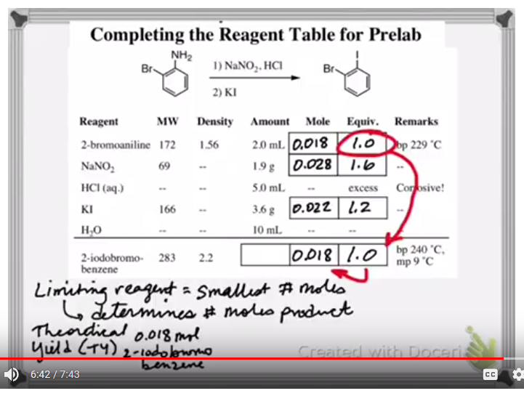
Making videos: iPad screencasting
Making videos
Lecture-capture w/iPad apps - can export videos to YouTube Explain Everything Cyclohexane and Doceri Reagent Table

Slide 19
Sharing your work
Sharing your work
Private (LMS) or Public (webpage link, MERLOT)
Include captioning for accessibility (Hablas Español? Si!)
Maximum exposure: make a YouTube channel!
ChemistryConnected, created in 2012, has over 500,000 views and over 1,000 subscribers
Pre-lab tutorials, solved problems, demos of hands-on elementary school science activities
Over half the views have come from outside the U.S. (200 different countries)
http://www.youtube.com/user/ChemistryConnected

Slide 20
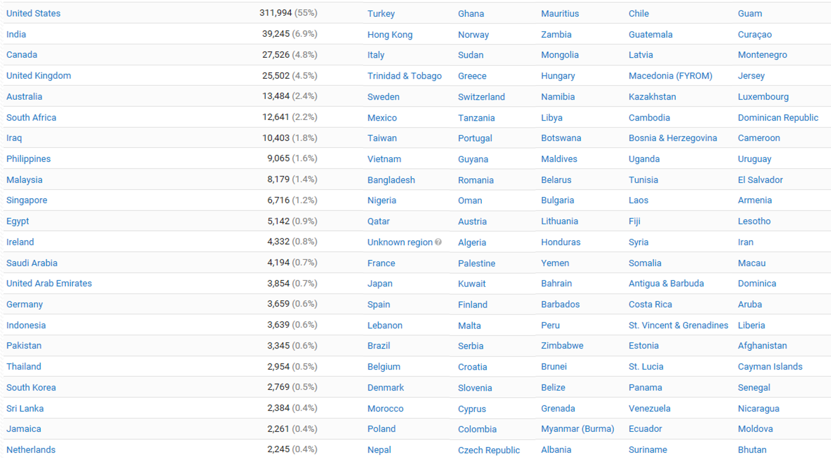
Sharing your work
Chemistry Connected YouTube Channel

Slide 21
Scholarship of Teaching and Learning
Making it Academic – SoTL Research
Turn your innovation into a research project!
Formulate a question
Collect data (can be a great “wow” factor)
Get IRB approval (Human Subjects)
Pre- vs. Post-Intervention
Quantitative and Qualitative data
Perform assessment; analyze data
Share results with colleagues and the world!
Conference paper, Ed. Journal article, RTP

Slide 22
Buy-in and support
Getting Buy-In and Support from Students, Faculty, Institution
Poorly implemented interventions unlikely to succeed
If you are enthusiastic, students are likely to be too
Explain WHY you do what you do – pedagogy matters!
Share data and testimonials and data with colleagues – encourage a SoTL-supportive culture
Institutional $upport: workshops, summer institutes, release time, mini-grants, free iPads (!), Faculty Learning Communities (clicker, SoTL, EdTech)
Collaborate with research students, other institutions…

Slide 23
Take-Home message
Take-Home Message: Variety in Teaching = Engaged Students
Audiovisual presentations blows away text and builds relationships
Interactive lessons exercise different “muscles”
Teaching to learning styles is a “neuromyth,” but audio & captioning helps ALL learners
Online tools offer asynchronous and mobile delivery, pause button, unlimited replay, etc.
Most students need more than textbook support! Online homework and adaptive learning tools enable immediate feedback/ formative assessment

Slide 24
Thank you
Support & Acknowledgments
CPP Faculty Center for Professional Development Investigating Teaching & Learning Fellowship, Connecting Learning & Technology FLC, Clicker FLC, countless workshops Dr. Victoria Bhavsar, Dr. Peggy Perry, Dr. Carol Holder
CPP eLearning, CPP Mediavision Animations, Lightboard, Video production
Terry Hogan, April Dawn, Bo Choi, Tommy Gaston, Erick Zelaya
Grants: CSU Course Redesign with Tech x3, CPP SPICE x2, CSUPERB Photo by Logan Crouch, duck pond 9_MG_1140

Slide 25
Thank you! Questions?
Laurie Starkey
Cal Poly Pomona
lsstarkey@cpp.edu

